Slide 1
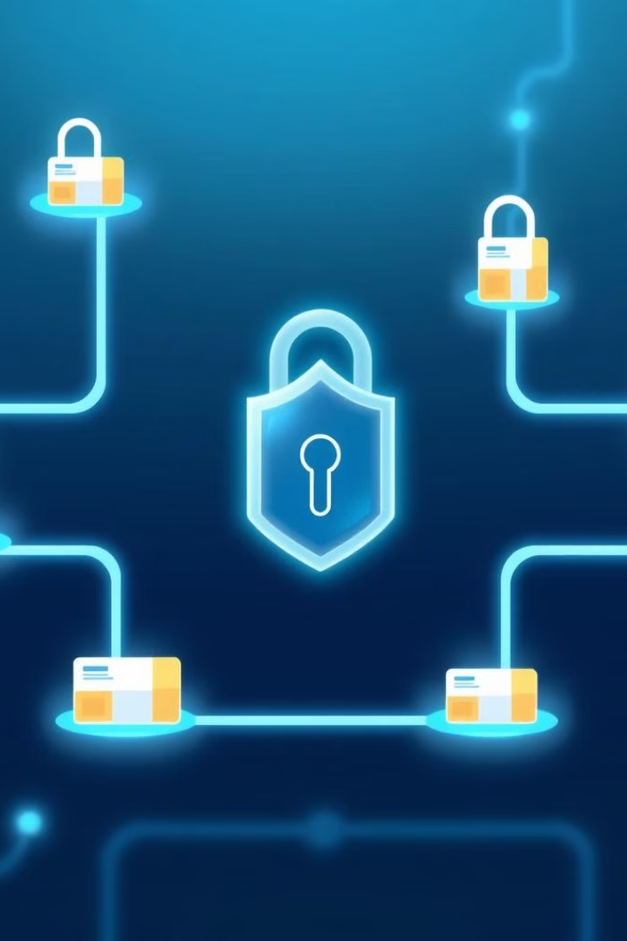
Drug Supply Management System using Blockchain
This presentation details a drug supply management system leveraging blockchain technology for enhanced security and transparency.
The system uses smart contracts, React, Node.js, Metamask, Truffle Suite, and Ganache.

Slide 2
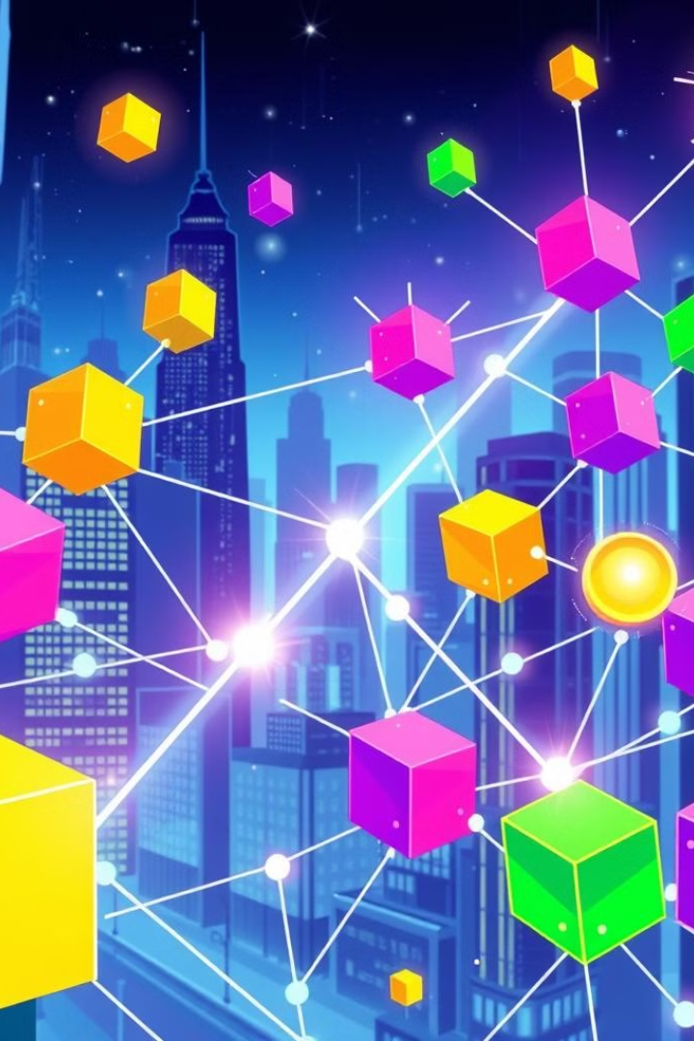
Introduction to Blockchain Technology
1
Decentralized Ledger
2
Transparency
Blockchain is a shared, immutable ledger.
All transactions are transparent and auditable.
3
Security
Cryptographic hashing ensures data integrity.

Slide 3

Smart Contracts and their Role
Automation
Transparency
Security
Smart contracts automate drug tracking and verification.
All contract executions are recorded on the blockchain.
Smart contracts eliminate intermediaries, reducing risks.

Slide 4
React, Node.js, and Metamask Integration
React
Node.js
Metamask
Frontend development for user interface.
Backend server for API and blockchain interaction.
Enables secure user interaction with blockchain.

Slide 5
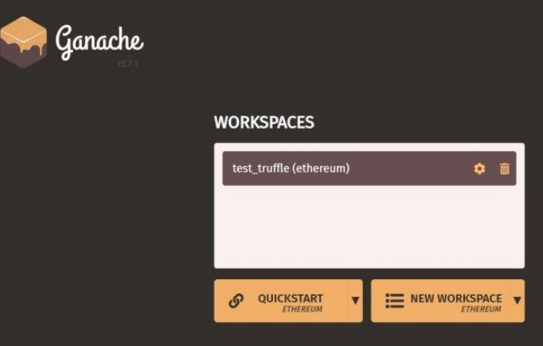
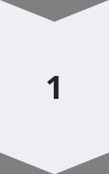
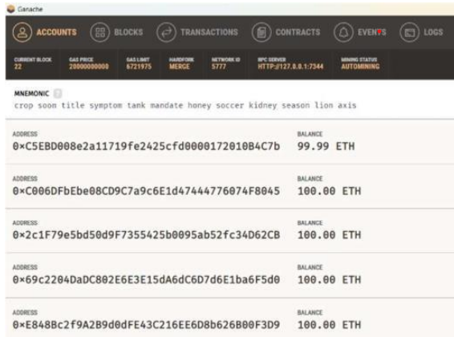
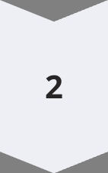
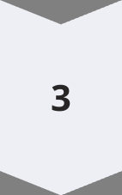
Truffle Suite and Ganache for Development
Truffle
Framework for building, testing, and deploying smart contracts.
Ganache
Local blockchain for development and testing.
Deployment
Deploy the smart contracts to a live blockchain network.

Slide 6
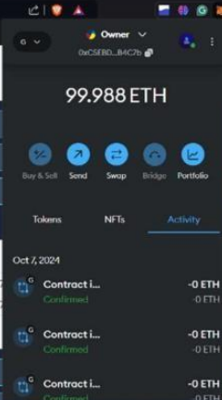



Blockchain Development Platform
Ethereum
The platform for smart contract deployment.
Network
A decentralized and secure network.
Security
Ensures data integrity and immutability.

Slide 7
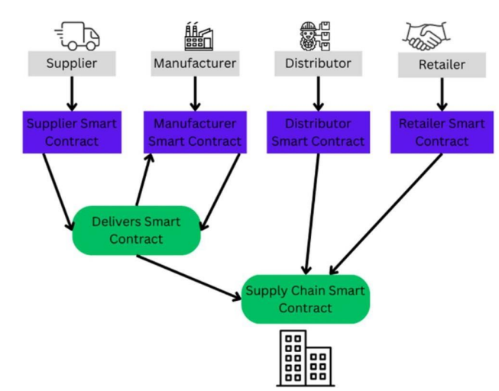
Working of the Drug Supply Management System
1
Supplier
Drugs are Supplied and logged on the blockchain.
2
Manufacturing
Drugs are manufactured and logged on the blockchain.
3
Distribution
Tracking of drug movement through the supply chain.
4
Retail
Verification of authenticity at the point of sale.

Slide 8
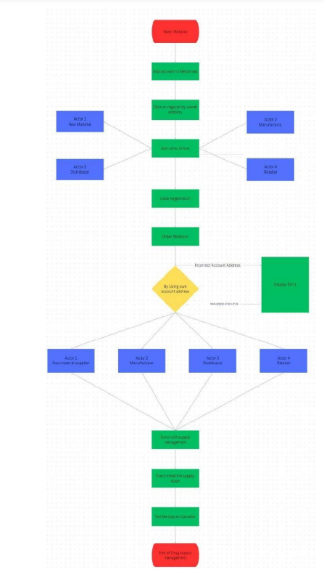
Process Diagram of the Site
User Enters the App
Check for Existing Account
Login Process
Registration Process
Home Screen
Raw Produce
Manufacturer
Distributor
Retailer
Logout Button
Tracking Section
Logout

Slide 9
Conclusion and Future Enhancements
Enhanced Security
Improved Traceability
Reduced Counterfeiting
Efficient Inventory Management
Enhancing Interoperability with Existing Systems: Future efforts will focus on ensuring that the Drug Guardian platform can seamlessly integrate with existing healthcare systems, including electronic health records (EHR) and pharmacy management systems. This will improve data flow and collaboration among stakeholders. By pursuing these initiatives, the Drug Guardian platform will continue to evolve as a comprehensive solution for ensuring the integrity and safety of the drug supply chain, ultimately benefiting patients and healthcare providers alike

